Slide 1
CTSA and Community Engagement in Research
The UF-FSU hub is supported by the National Center for Advancing Translational Sciences of the National Institutes of Health under University of Florida Clinical and Translational Science Awards UL1TR001427, KL2TR001429 and TL1TR001428.

Slide 2
Overview
What is the Clinical and Translational Science Award (CTSA)?
How is FSU CTSA integrating with FSU Health Research (Office of Clinical Research Advancement; OCRA)?
What will the Community Engagement Hub offer?
Case Example: Implementation of a Community Engaged Research Framework

Slide 3
NIH NCATS:
National Center for Advancing Translational Science
Who We Are
Transform Research
Develop new capabilities and translate them into practice
Provide Services
High-quality, efficient resources for translational research.
Cultivate Workforce
Build a skilled translational research workforce.
Collaborates with UF, FSU,
and 60+ CTSA institutions nationwide.

Slide 4
About the CTSA Program
Goal: to speed the translation of research discoveries into improved care
Includes modules on bioinformatics, community engagement, and translational workforce development
Focus on overcoming translational science barriers using translational science principles

Slide 6
What is CTSA and What it is not?
Overcomes roadblocks to enhance efficiency of translational research
Generalizes solutions across a range of diseases/conditions
Facilitates interactions between institutions, researchers, and community partners
Supports clinical research offices that execute the trials (FSU Health Research Connection)

Slide 7
What is CTSA and What it is not?
CTResearch
CTScience
Evaluate the toxicity of a new compound to treat Alzheimer’s
Identify early biomarkers of multiple sclerosis
Recruit historically underrepresented groups into a clinical trial of breast cancer
Generate a research database of patients with diabetes in Panhandle
Develop new assay types based on human cells that can identify potential toxicities better than current animal testing methods
Develop framework/models to identify biomarkers to gauge intervention efficacy
Systematically study barriers to enrollment of historically underrepresented groups in clinical trials
Develop systems to merge clinical datasets from different sources efficiently

Slide 8
FOUR PILLARS of FSU CTSA 4.0*
Translational Workforce Development (TWD)
Emerging faculty programming, mid-career faculty programming, T32s, Mentoring Academy
Biostats, Informatics, Research Design (BIRD)
Study design, data analysis, clinical informatics
Integrates with FSU Health BIRD Hub
CTS Evaluation
Evaluates CTSA activities and can support evaluation of health research services (e.g., needs assessments)
Integrates with FSU Health Research Development Hub
Addressing CTS Barriers
Tools and expertise to overcome CTS barriers; CTS pilots
Integrates with FSU Health Clinical Research Hub and Community Engagement Hub
*Currently in a gap year; UM1 reviewed end of March with ~July 1, 2025 start

Slide 9
FSU HEALTH RESEARCH SERVICES INTEGRATION (DRAFT)

Slide 10
FSU Health Research
Community Engagement Hub
Proposed Activities
Continuously update resources on the science of engagement
Maintain database of multisectoral community partners
Represent FSU Health Research Connections in Provost Office
Develop, implement, and evaluate strategies to build community trust in FSU Health
Develop and maintain community recruitment venues using best practices
Maintain infrastructure of community health workers
Conduct community engagement pilot studies to reduce translational science barriers
Provide multisectoral training
Maintain a roster of community advisors
Support the CTSA Community Engagement Core

Slide 11
FSU CTSA Proposed Internal Aims
To support the roll out of FSU Health Research Connections
Transition from NCRT-CE to the FSU Health Clinical Research Hub
Transition from NCRT-CE to FSU Health Community Engagement Hub
Support expansion of FSU Health BIRD Hub
To conduct community engaged recruitment pilots in collaboration with TMH, FSU PrimaryHealth, and other clinic partners
To support the TWD K2R program and T32 applications, and develop new programming for associate professors, health research professionals, and nursing/medical students
To integrate with UF efforts to overcome translational science barriers including two pilot projects that integrate data science with implementation science

Slide 12
Questions?

Slide 13
Case Example: Community Engaged Research

Slide 14
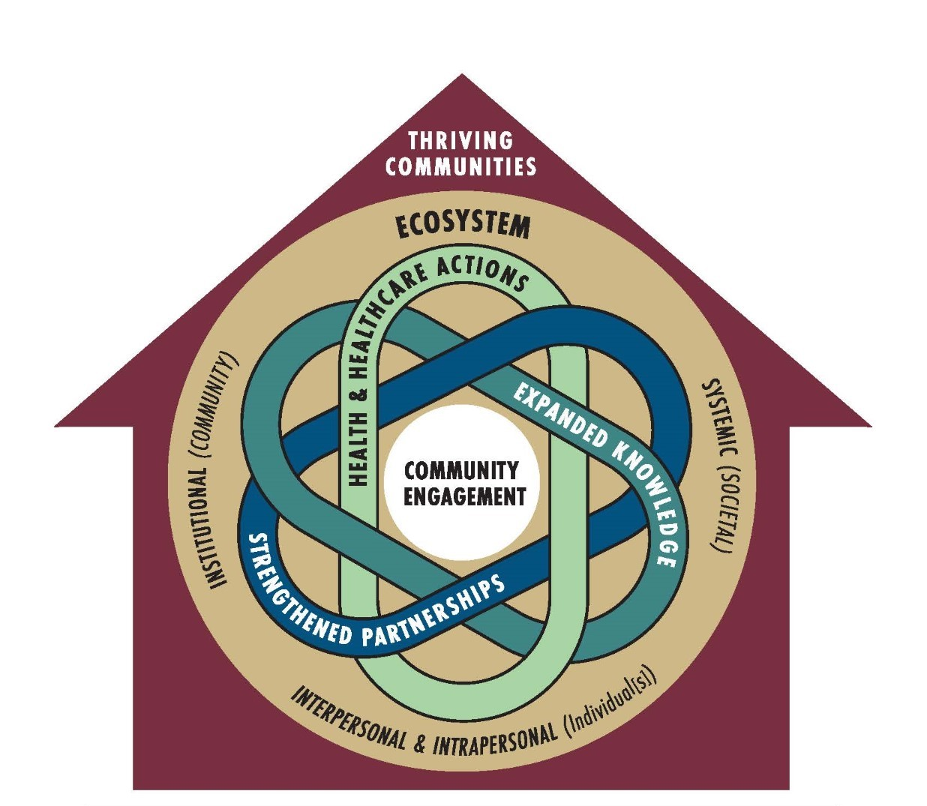
“What gets measured gets done” Academy of Medicine Transformative Health Justice Framework

Slide 15
Pillar 1: Strengthened Partnerships
DIVERSITY & INCLUSIVITY
BENCHMARK 1
Perspectives reflect the composition of the community and the multidisciplinary expertise from the community (academic, healthcare systems, and broader community, intentional integration of interests, knowledge, resources, perspectives).
EVIDENCE ACHIEVED BENCHMARK
As evidenced by document describing role, institution or system represented, and uniqueness of perspective represented across advisory groups and committees and lessons learned from phase 0
As evidenced by approved initial GMB recruitment plan

Slide 16
Pillar 1: Strengthened Partnerships
PARTNERSHIPS & OPPORTUNITIES
BENCHMARK 1
Participants/Council members/People’s Committee benefitted from beginning to identify recognition of inequities and antiracism strategies, etc.
EVIDENCE ACHIEVED BENCHMARK
As evidenced by mentions of mutual benefits – info gathering, listening sessions, historical interviews, People’s committee
As evidenced by open-ended question of GMB participants at end of follow-up workshop (e.g. what was benefit of GMB?)

Slide 17
Pillar 1: Strengthened Partnerships
ACKNOWLEDGMENT, VISIBILITY, RECOGNITION
BENCHMARK 1
Community members are seen and recognized as experts and as critical sources of information for problem framing
EVIDENCE ACHIEVED BENCHMARK
As evidenced by who we talked to in community narratives (listening session, historical interviews, information gathering) and GMB workshop design (providers, broader community, patients) represented in a final gathering plan document in Pillar 1 (significant clinical question Orbit)
BENCHMARK 2
Acknowledgement in dissemination products. Acknowledgements are provided to/reviewed by ANY and ALL members of the CAC, SAC, and People’s Committee (e.g., do you want to be named in dissemination products)
EVIDENCE ACHIEVED BENCHMARK
As evidenced by an acknowledgement tracking form (will be updated for each phase)

Slide 18
Pillar 1: Strengthened Partnerships
SUSTAINED RELATIONSHIPS
BENCHMARK 1
Develop a sustainability plan beyond the 5-year period
Collaboratively developed Community Outreach plan including branded one pager
EVIDENCE ACHIEVED BENCHMARK
As evidenced by Draft of the sustainability plan
As evidenced by Approved plan and one-pager uploaded to Teams
BENCHMARK 2
Commitments to the sustainability plan
EVIDENCE ACHIEVED BENCHMARK
As evidenced by Draft of the outreach plan
As evidenced by Approved plan and one-pager uploaded to Teams
As evidenced by a plan that Council members and People’s Committee list their names and the organizations that they represent

Slide 19
Pillar 1: Strengthened Partnerships
MUTUAL VALUE
BENCHMARK 1
Community - Mutual problem definition and establishing system boundaries for study population (i.e. what is the community priority for improved health – e.g., adequate mental health care; chronic illness management; retention in primary care, etc.)
Healthcare system - Mutual problem definition and establishing system boundaries for study sites (in essence what is the study sites priority for improved health – e.g., adequate mental health care; chronic illness management; retention in primary care, etc.)
EVIDENCE ACHIEVED BENCHMARK
As evidenced by: Mutually defined goals demonstrated in a problem statement and systems map for study population
As evidenced by: Mutually defined goals demonstrated in a problem statement and systems map for healthcare partners
BENCHMARK 2
Consistent attendance at the GMBs
EVIDENCE ACHIEVED BENCHMARK
As evidenced by 70% attendance rates

Slide 20
Pillar 1: Strengthened Partnerships
TRUST
BENCHMARK 1
Developed & streamlined contact / communication plan with study sites & community advisory groups
EVIDENCE ACHIEVED BENCHMARK
Communication Plan SOP for study sites (TMH/CHP)
Communication Plan SOP for Community Advisory Council & People’s Committee
Establish & maintain relationships with the highest levels of each organization
BENCHMARK 2
All research team members have training in cultural humility, racism/antiracism, & developing trustworthiness
EVIDENCE ACHIEVED BENCHMARK
As evidenced by Investigator Report
As evidenced by: Training Packet
BENCHMARK 3
Protocol/ SOW of what CAC is reviewing – Community advisory council approves protocol for reviewing anything public facing
EVIDENCE ACHIEVED BENCHMARK
As evidenced by meeting minutes or email approval

Slide 21
Pillar 1: Strengthened Partnerships
SHARED POWER
BENCHMARK 1
Plan for joint facilitation of GMB
EVIDENCE ACHIEVED BENCHMARK
As evidenced by GMB facilitation Manual
BENCHMARK 2
Joint facilitation of nonpatient community focus groups with People’s Committee
EVIDENCE ACHIEVED BENCHMARK
As evidenced by meeting minutes
BENCHMARK 3
CAC provides feedback on dissemination materials for this phase
EVIDENCE ACHIEVED BENCHMARK
As evidenced by meeting minutes

Slide 22
Pillar 1: Strengthened Partnerships
STRUCTURAL SUPPORTS FOR COMMUNITY ENGAGEMENT
BENCHMARK 1
Manualized depiction of this phase
EVIDENCE ACHIEVED BENCHMARK
As evidenced by researcher and advisory groups review manual depiction of this phase Conceptual framework
BENCHMARK 2
Community Engagement paper drafted
EVIDENCE ACHIEVED BENCHMARK
As evidenced by researcher and advisory group feedback on Pillar 1 paper

Slide 23
Additional Pillars / Future Directions
EXPANDED KNOWLEDGE • Curricula, strategies, and tools • Bi-directional learning • Community ready information • ORBIT Phase 1A Define Continued
HEALTH AND HEALTHCARE ACTIONS • Community aligned solutions • Actionable, implemented, and recognized solutions • Sustainable solutions • ORBIT Phase 1B Refine
THRIVING COMMUNITIES • Physical and mental health • Community capacity, connectivity. and power • Community resiliency • Life quality and well-being • ORBIT Phase 2 and Beyond

Slide 24
Questions?

